Slide 1
Week 1 Material

Slide 2
Exploratory v Explanatory
Exploratory – What you do to understand the data and figure out what might be noteworthy or interesting to highlight
Do not show all of the work you did
Explanatory – What the data actually telling us

Slide 3
Explanatory analysis
Who – audience
You – what is your relationship to the audience
What – what do you need your audience to know or do
Action or recommendation
How – What data is available to make my point

Slide 4
More on What
Action – Always have a recommendation or action item
Mechanism – how do you deliver your message: presentation vs e-mail
Tone – what tone do you want to convey – celebratory vs. cautionary

Slide 5
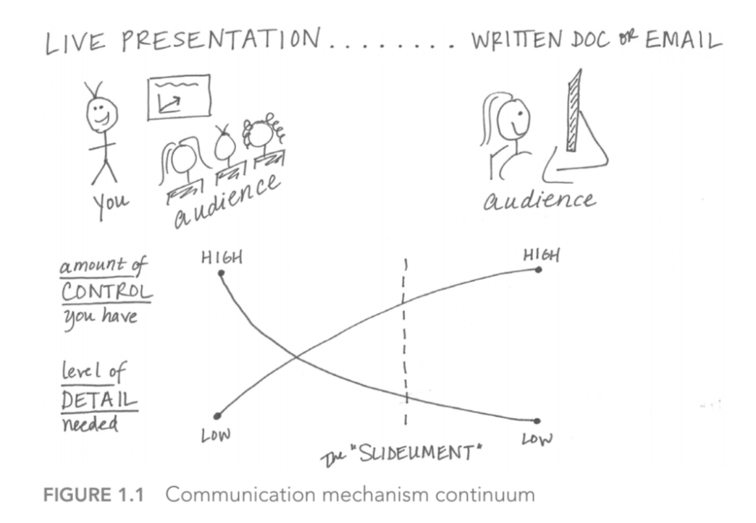

Slide 6
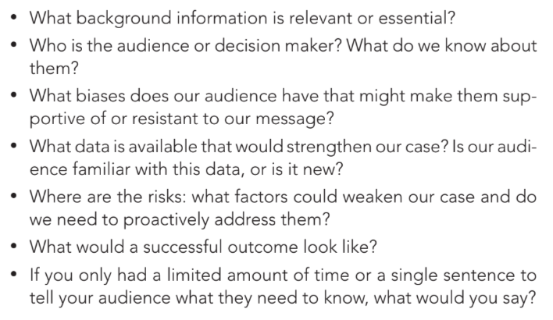
Consulting for Context

Slide 7
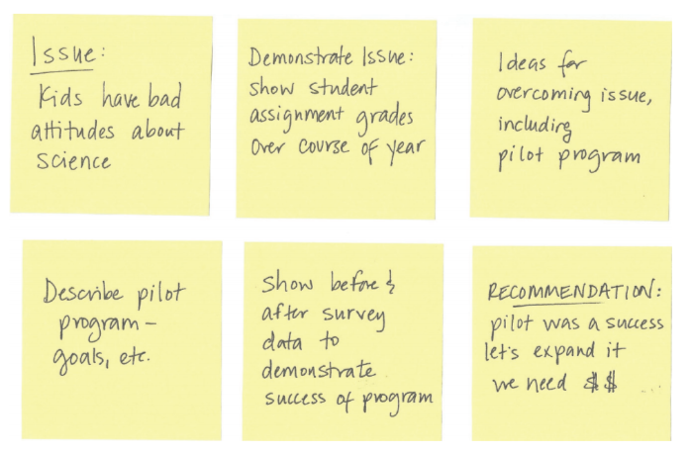
Storyboarding

